Slide 1
Voltage, Current, Resistance & Ohms Law

Slide 2
What is electricity?
Electricity = movement of electrons. (electrons = subatomic particles)
Early research up until 1700’s considered electricity a fluid.
We use these electrons to do work for us
Charge of electrons summed up with voltage, current, resistance.

Slide 3

Voltage
Potential energy between two points in circuit
Voltage different types of power:
types: AC / DC power (rock on )
AC (alternating current) power = more power. Cheaper, transmit further over long distances.
DC(direct current) electricity . Misc methods creating DC power.

Slide 4
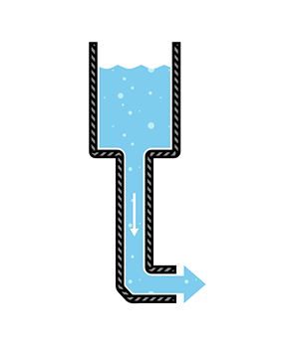
Voltage cont…
DC like tank with hose at end. Only flows one way (direction can be reversed)
Mostly all projects, components, etc you will work with are DC devices(including your laptops, cellphones, batteries, etc)
Voltage @ different ratings. Datasheets of products tell you product specs. Look on DC chargers. Will have written ratings

Slide 5
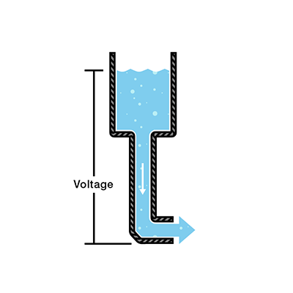
Voltage cont…
Continuing with the water analogy, voltage = pressure at end of water tank hose.

Slide 6
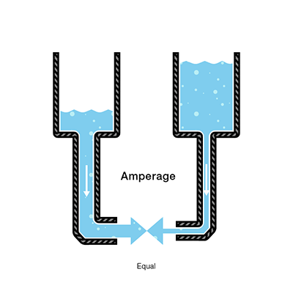
Current
Current = amount of flowing water from our tank. Higher pressure = higher flow
Current measured in Amperes (named after Andre-Marie Ampere a mathematician and physicist)
In ohms law (which we will look at shortly) Ampere symbol is “I” instead of “C” (C is reserved for unit of measure for Coulomb)
Summed up, water = charge (measured in coulombs), Pressure = voltage (measured in volts), Flow = current (measured in Amperes “amps”)

Slide 7
Current cont….
1000 mA (millamps) = 1 Amp
So, to represent say 120 mA to Amps, we represent in decimal form for Ohms law
120 mA = 0.12 Amperes

Slide 8
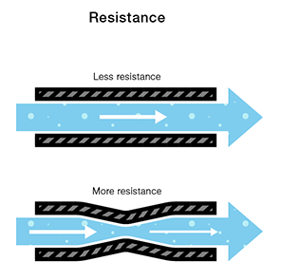
Resistance
The narrowness of the pipes consider at the resistance.
1 ohm = resistance between two points in conductor which application is 1 volt & 1 ampere.
Current & voltage are directly related to each other.

Slide 9
What is Ohms law?
Formula electric potential difference between two points on a circuit (V) is equivalent to the product of the current between those two points (I) and the total resistance of all electrical devices present between those two points (R).
Basic formula in electronics.

Slide 10
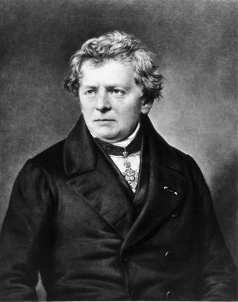
Georg Ohm
1789 - 1854
German physicist/mathematician
Begun own research on
electrochemical cell (device generates energy from chemical reactions) invented by Alessandro Volta
Discovered proportionality between the potential difference (voltage) applied across conductor , resulting in electric current.

Slide 11
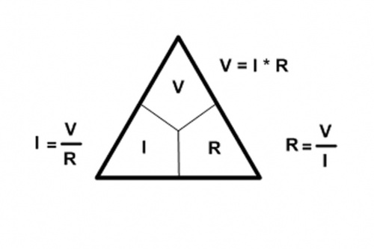
Ohms Law Equation
three variables: voltage, current, resistance
V = I * R (depending on which variable you are trying to solve for)

Slide 12
Ohms Law
So:
I = Ampere (need to convert mA to Amp in decimal)
V = volts
R = resistance in 1 Ohm (convert kiloohm to ohm )

Slide 13
Resistors
Electrical component creating resistance in a circuit & at same time lower voltage levels (remember how current/voltage is directly related? )
Only consume power.
Resistor measured in ohms Ω . (ohm, kiloohm, megaohm)

Slide 14
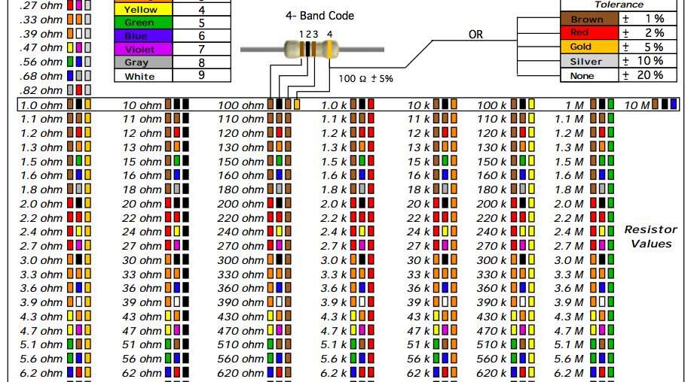
Resistors chart

Slide 15
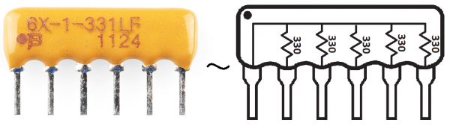
Shapes, colors, sizes

Slide 16
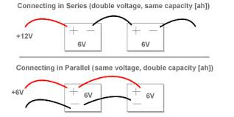
Series vs parallel circuits

Slide 17
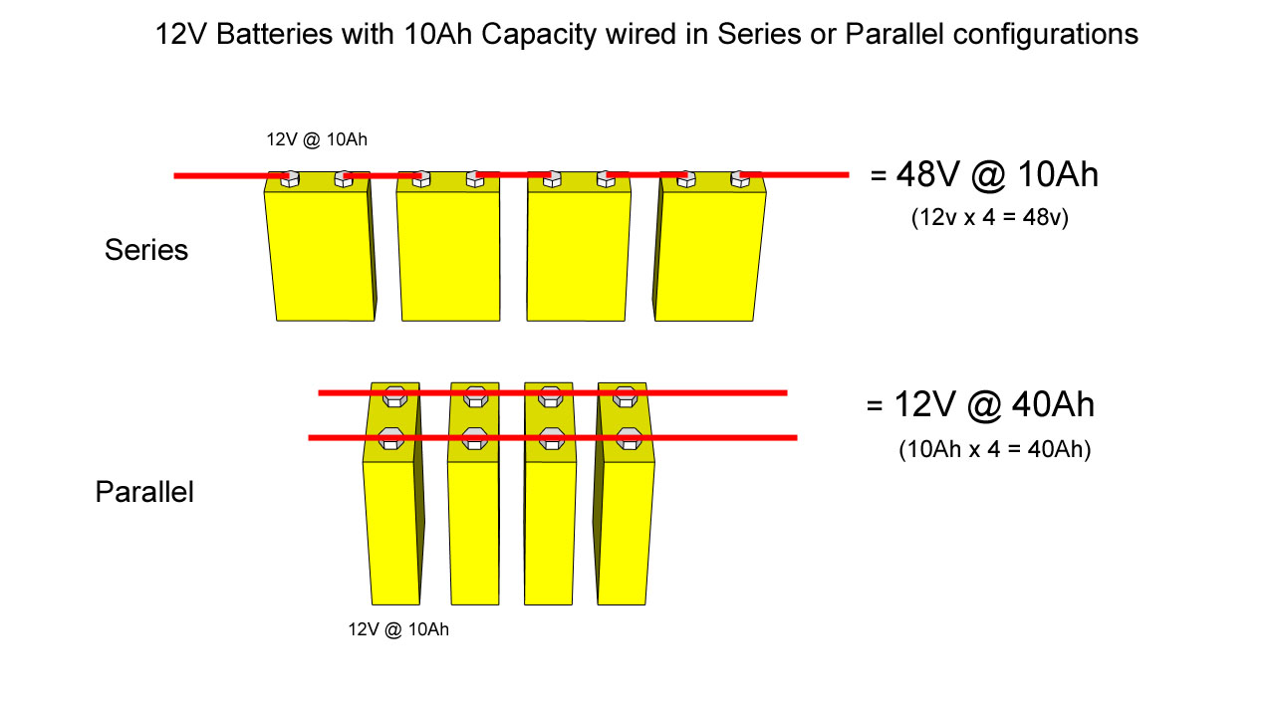

Slide 18
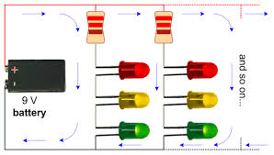
Leds series & parallel combo
Voltage in Ohms law increases! 3 LEDs = 9V

Slide 19
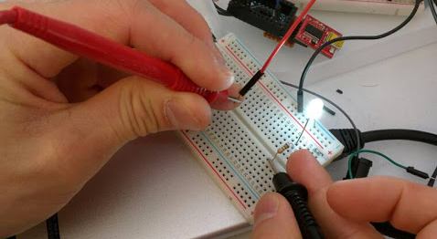
Testing current inside LED

Slide 20
resources
https://learn.sparkfun.com/tutorials/voltage-current-resistance-and-ohms-law (thumb through documentation on here. Great site)
https://learn.adafruit.com/

